Slide 1

CURRICULUM VITAE ANALYSIS USING DEEP LEARNING Department of Computer Science and Engineering Under The Esteemed Guidance Of Mrs . J. LAKSHMI _{M. Tech} Assoc. Professor PRESENTED BY
M.Anuhya (20NE1A05A1) K.Gayathri Venkata Aasritha (20NE1A0571) N.Chandu Venkat sai (20NE1A05B3) M.Dinesh Babu (20NE1A0597) M.Harshitha (20NE1A0595)
M.ANUHYA | 20NE1A05A1
K.GAYATHRI VENKATA AASRITHA | 20NE1A0571
N.CHANDU VENKAT SAI | 20NE1A05B3
M.DINESH BABU | 20NE1A0597
M.HARSHITHA | 20NE1A0595

Slide 2

Contents:
Abstract
Introduction
Literature Survey
Existing System
Proposed System
System Requirements
System Architecture
Design Algorithm
UML Diagrams

Slide 3
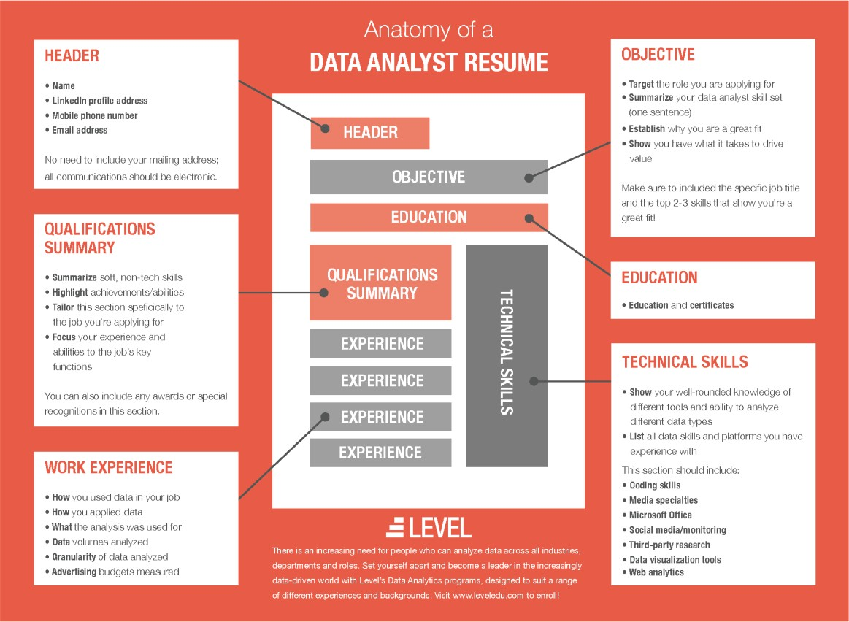
Introduction:
Personality is the most important factor which reflects an individual, which keeps on varying.
Tackling them is a tedious task for which we have implemented an approach to identify the personality and also provide with the recommendation. This will enable a more effective way to short list submitted candidate CVs from a large number of applicants providing a consistent and fair CV ranking policy, which can be legally justified.
System will rank the experience and key skills required for particular job position.
So, it will help the HR department to easily shortlist the candidate based on the CV ranking policy.

Slide 4
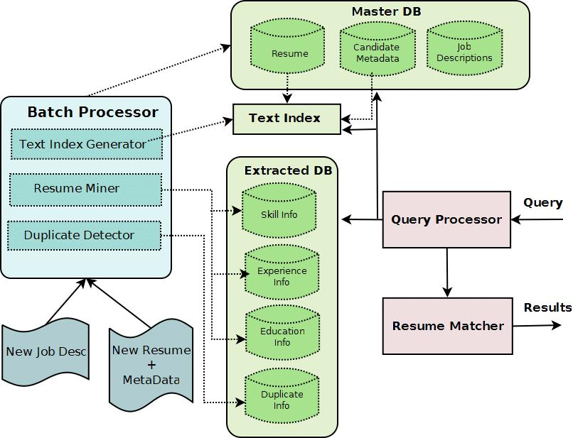
BIG FIVE PERSONALITY MODEL:
Big Five Personality Model (also known as Five Factor Model) has been used to predict the personality of the candidate which includes Openness, Conscientiousness, Extraversion, Agreeableness and Neuroticism.
Openness - How open a person is to new ideas and experiences
Conscientiousness- How goal-directed, persistent, and organized a person is
Extraversion- How much a person is energized by the outside world
Agreeableness - How much a person puts others' interests and needs
ahead of their own
Neuroticism - How sensitive a person is to stress and negative emotional trigger
For classifying the person Automated Personality Classification is used,
which is used to classify the person from a large number of people.
Recommendation using machine learning techniques have been used
for the analysis of the CV. In literature, various evaluation tools have been used.
One of the approaches has been mentioned in which use a tool
called “PROSPECT” for screening candidates for the recruitment.

Slide 5
Abstract:
We describe a system called CV analysis machine, that processes a set of given free-form textual resumes (in English for IT domain), creates a standardized profile for each candidate, and for a given job description, identifies a ranked shortlist of k candidates, along with a matching score for each.
Companies often receive thousands of resumes for each job posting and employ dedicated screeners to short list qualified applicants.
To shortlist the candidates we are using the ranking policy so the decisions will be fair.
In this, we present “PROSPECT”, a decision support tool to help these screeners shortlist resumes efficiently. Prospect mines resumes to extract salient aspects of candidate profiles like skills, experience in each skill, education details and past experience.

Slide 6
Literature survey:
Jenal Parmar devised a system in choosing the best candidates for open vacancies. The HR department will include the qualifications, experience, and other details required for a particular job position. The system will take the details and CV/Resume of the candidates and then shortlist the right person suitable for that job profile.
Allan Robey built a system using modern technology where it will help to pick the right candidates by using weight-age policy and an aptitude .
Sudhir Bagade says that personality plays an important role in one’s individual life.The system uses the TF-IDF algorithm to select the right candidates.
Atharva Kulkarni built a system using different machine learning algorithms for predicting the personalities of the candidates using Natural Language Processing, Random Forest achieves better accuracy than remaining algorithms such as KNN, Logistic Regression, Support Vector Machine, and Naive Bayes.
VVCET-CSE The system will predict the personality based on the ranking policy.
Afroja Khatun Monalisa built a model using the Random Forest Algorithm, Support Vector Machine, and Weighted Majority Voting algorithm.

Slide 7
Existing System:
The candidates will register themselves with the required details in the CV form and upload the documents for verifying the authenticity of the information provided in the CV registration form.
In order to apply for a job the candidates needs to be eligible for that job by satisfying all the requirements as stated by the recruiter.
If a candidate applies for a specific job, the system checks whether the candidate meets all the requirements/parameters as specified by the recruiter.
If the Candidate meets the requirements then the online test will be conducted on personality questions as well as aptitude questions. After completing the online test, candidate can view their own test results.
The system would then derive and rank the candidates who were eligible for the job. The rank of each candidate acts as a score of how well the candidate’s profile meets the specifications of the recruiters as well as cumulative score of the the aptitude test.
The recruiter could also analyze the personality of the candidate based on the result of the personality test. So, based on CV, aptitude test and the personality test the candidate would be selected.

Slide 8
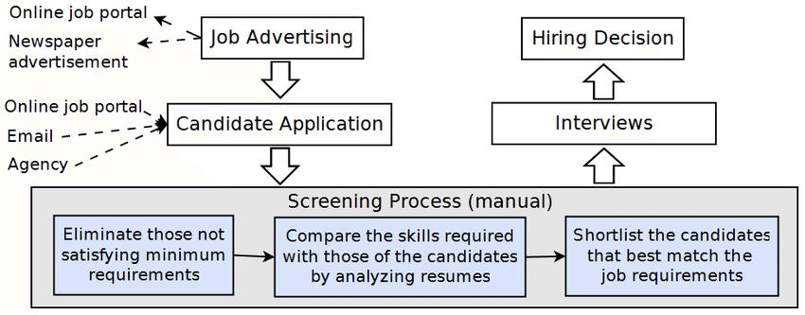

Slide 9
Disadvantages of Existing System:
This system requires large memory space as it stores data related to CV’s.
Requires an active internet connection.
May provide inaccurate results if data not entered properly.
To verify all the candidates forms it takes more time.
There is a huge workload on the human resource department to select the right candidate for a particular job profile which in turn would provide experts workforce for the organization from a large pool of candidates.

Slide 10
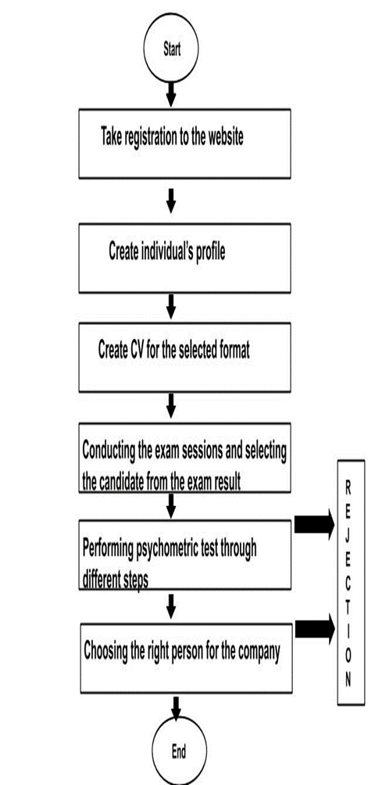
Proposed System:
The proposed system will enable a more effective way to
short list submitted candidate CVs from a large
number of applicants providing a consistent and fair CV
ranking policy. This can be legally justified.
System will rank the experience and key skills required
for a particular job position than system will rank the CV’s
based on the experience and other key skills which are
required for particular job profile.
This system will help the HR department to easily shortlist
the candidate based on the CV ranking policy.

Slide 11
Advantages of proposed system:
This system employs a machine learning algorithm namely “Logistic Regression” which helps to choose fair decisions to recruit a suitable candidate.
It has the potential to transform research and assessment in personality psychology. Algorithms can handle vast datasets, including thousands of attributes, without succumbing to collinearity issues. Moreover, ML algorithms are highly efficient in recognizing patterns in datasets that humans cannot even perceive.
It does not consume more time to identify the personalities.
This predictive personality makes the recruiters understand if a candidate will be a top performer and fit to the culture of the company easily.

Slide 12
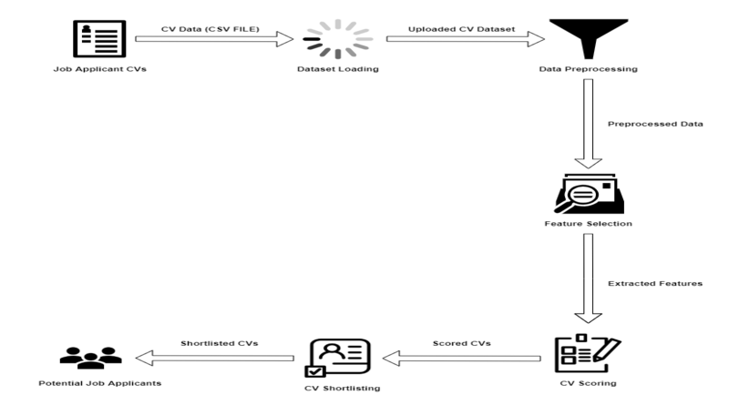
System Architecture:

Slide 13
Requirements Specifications:
Hardware Requirements:
Processor : Intel I5 Core
Hard disk :1TB
RAM :8GB or above
Software Requirements:
Operating System :Windows 10 or above
Coding language :Java
IDE :NETBEANS 15

Slide 14

Modules:
2.VIEW :
This module enables the user or officer to view the content in the document and observe the format of the cv is suitable for your application and this module offers to head officials to read a particular cv and check for there is any tricks are apply for the grade.
1.LOAD CV:
To analyze the cv at first we need to load the file containing the information about the person who want to analyse,we load the any number of cv by just clicking the button add and it shows the popup window and we select the file using the path of the file by file chooser.

Slide 15
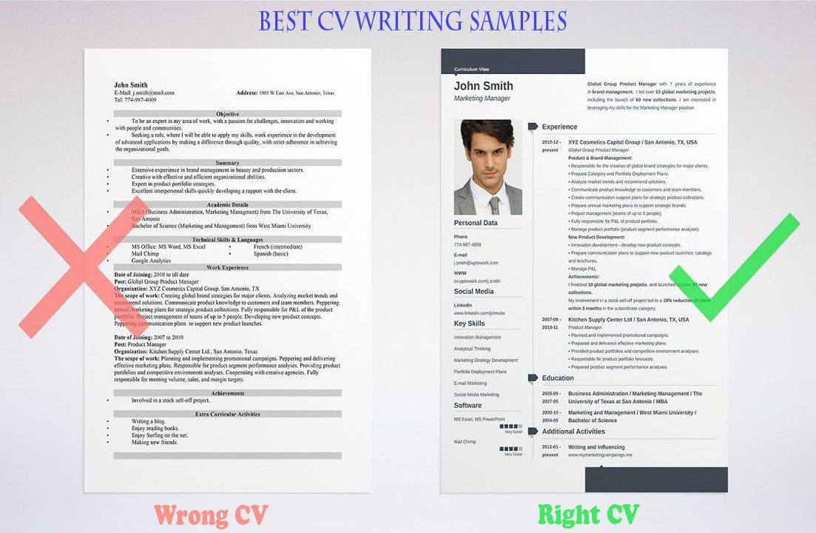
3.ANALYZE ONE:
We can also analyze the one cv at a time by using the module analyze one panel , we simply type the file name in the text field provided in the same panel.After loading the file into the panel it analyze the cv and give the information about the candidate and his overall grade and overview in all fields.
4.ANALYZE ALL:
We can also analyze the all cv we loaded into the application in this windows shows the all the grades for the each applicant.

Slide 16
Design Algorithm:
In this section we state the machine learning algorithm (TF-IDF) for CV analysis. The TF-IDF Algorithm is used to find out the important keywords in a document/CV. Below, we give the working of TF-IDF in detail.
Step 1: Calculate TF (Term Frequency)
Term Frequency (TF) - Number of times a keyword appeared in a document is calculated by Term Frequency.
TF (‘keyword’) =number of times ‘keyword’ appears in document /Total number of keywords in the document. Here, the term ‘keyword’ signifies any job specific skill which the algorithm is searching for.
Step 2: Calculate IDF (Inverse Document Frequency) value.
The problem of rare and frequent words is resolved.
This helps our system to give more priority to the required word or skills.
IDF sets the log value=1 for the required CV as per skill sets and log value=0 for the unwanted CV.
IDF (‘keyword’) =log (total number of CV/Number of document with term ‘keyword’)
Step 3: Calculate TF-IDF weight
Weight= TF (‘keyword’)*IDF (‘keyword’)
Higher the weight, more relevant is the CV and lower the weight, less or no relevance of the CV for the selection process. This step returns the CV with highest and lowest weight values which is further useful for classification.

Slide 17
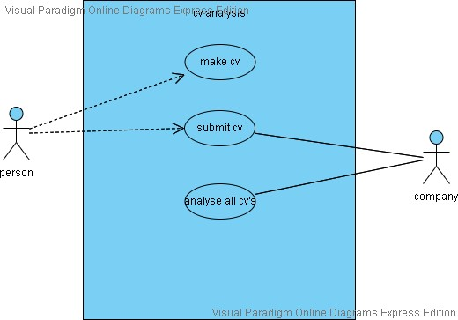
UML DIAGRAMS:
USE CASE DIAGRAM:
Unified Modeling Language (UML) is a type of behavioral diagram defined by and created from a Use-case analysis.Its purpose is to present a graphical overview functionality provided by a system in terms of actors, their goals (represented as use cases), and any dependencies between those use cases.

Slide 18
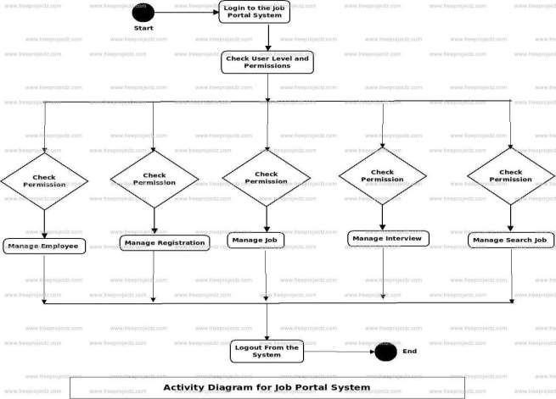
Activity diagram:
Activity diagrams are graphical representations
of workflows of stepwise activities
and actions with support for choice,
iteration and concurrency.
In the Unified Modeling Language, activity
diagrams can be used to describe the business
and operational step-bystep workflows of
components in a system.An activity diagram
shows the overall flow of control.

Slide 19
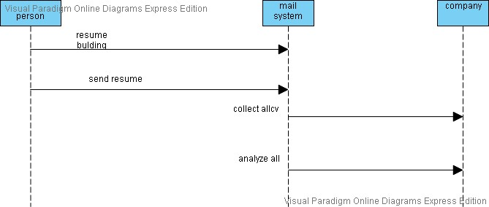
Sequence Diagram: A sequence diagram is a type of interaction diagram because it describes how and in what order a group of objects works together.

Slide 20
Sample code:
Importing the packages:
import java.awt.Graphics;
import java.awt.Image;
import java.awt.RenderingHints;
import java.awt.event.*;
import java.awt.event.MouseAdapter;
import java.awt.event.MouseEvent;
import javax.swing.*;
import java.io.*;
import java.text.DecimalFormat;
import java.util.Arrays;
import java.util.logging.Level;
import java.util.logging.Logger;
import javax.swing.border.BevelBorder;
import javax.swing.border.Border;
import javax.swing.filechooser.FileSystemView;

Slide 21
Login details:
loginb = new JButton("LOG IN");
loginb.setBounds(450, 500, 100, 30);
loginb.setForeground(Color.WHITE);
loginb.setBackground(Color.BLACK);
ImageIcon logini = new ImageIcon("C:\\Users\\--\\Downloads/a.jpg");
loginl = new JLabel();
loginl.setIcon(logini);
loginl .setBackground(Color.decode("#8ae6a2"));
loginl.setBounds(0, 0, 1200, 700);
loginl.add(password);
loginl.add(userid);
loginl.add(userid);
loginl.add(password);
loginl.add(loginb);
login = new JPanel();
login.setBounds(0, 0, 1200, 700);
login.setLayout(null);
login.add(loginl);

Slide 22
Viewing the data:
viewone = new JButton("VIEW");
viewone.setFont(new Font("sarif", Font.BOLD, 20));
viewone.setBackground(Color.decode("#8ae6a2"));
viewone.setForeground(Color.yellow);
viewone.setBounds(110, 0, 200, 40);
viewone.setBorder(null);
viewone.addMouseListener(new MouseAdapter() {
@Override
public void mouseEntered(MouseEvent me) {
viewone.setBorder(mb1b);
viewone.setBackground(Color.CYAN);
viewone.setForeground(Color.BLUE);
}
@Override
public void mouseExited(MouseEvent me) {
viewone.setBorder(BorderFactory.createEmptyBorder());
viewone.setBackground(Color.decode("#8ae6a2"));
viewone.setForeground(Color.yellow);
}
});

Slide 23
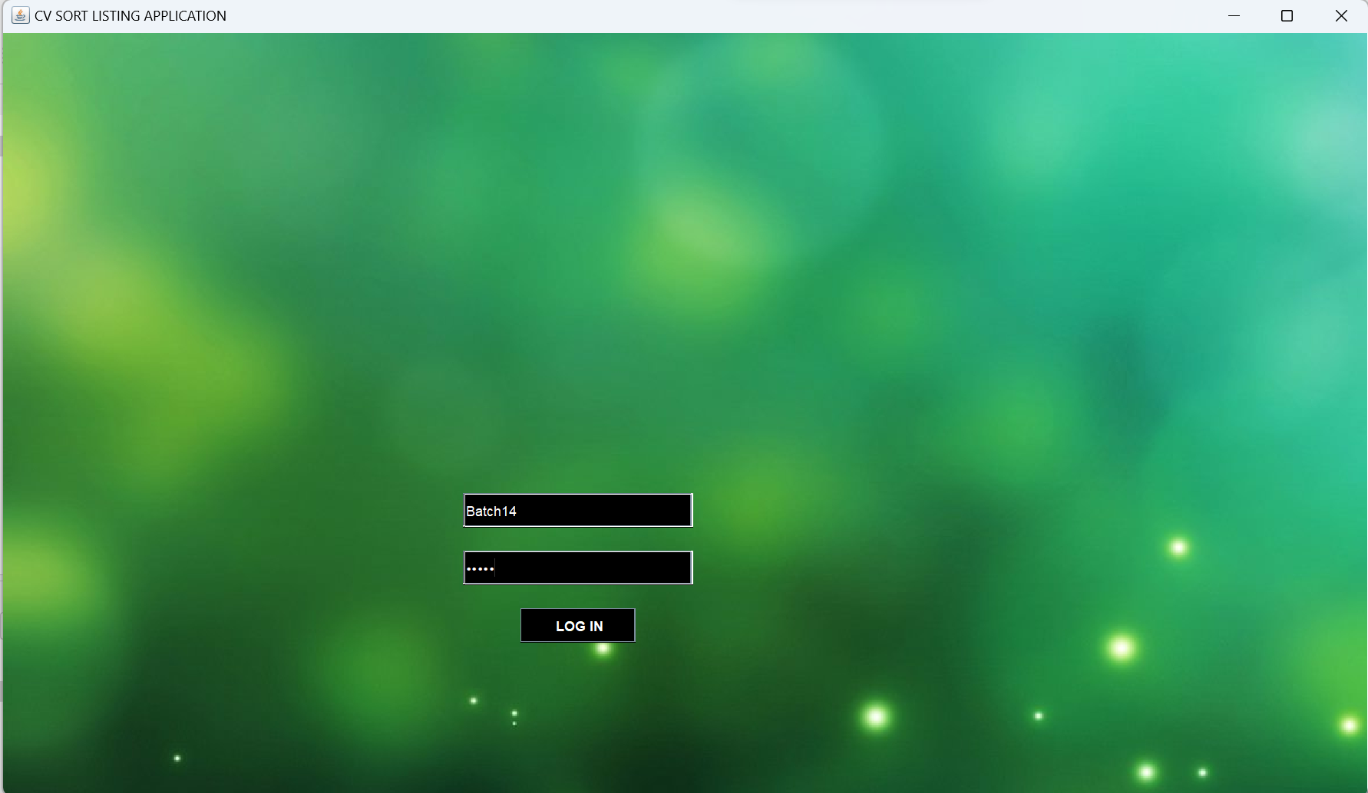
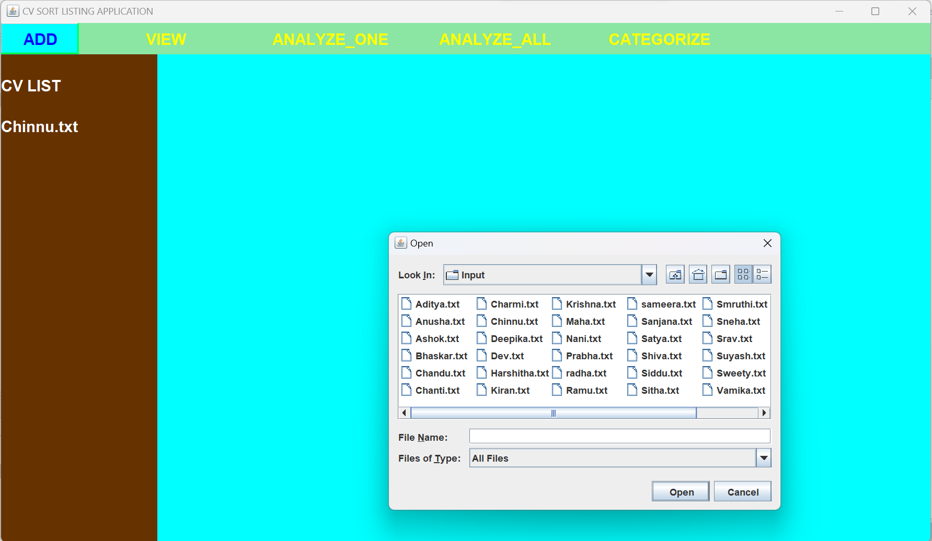
OUTPUT SCREENS:
ADMIN LOGIN
FILE CHOOSER

Slide 24
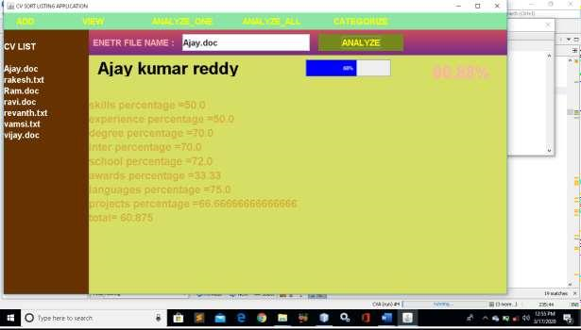
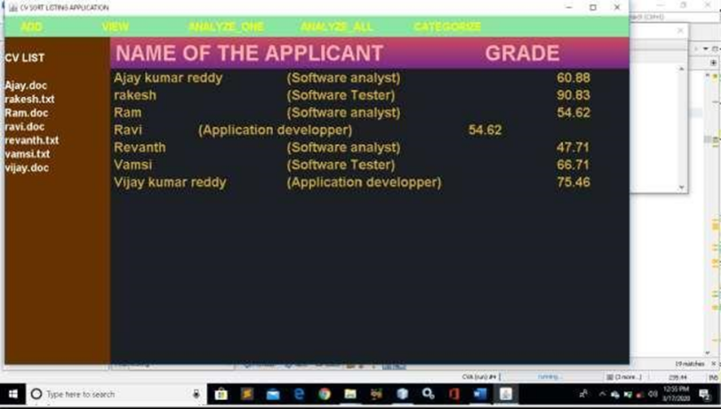
ANALYZE ONE CV
ANALYZE ALL

Slide 25
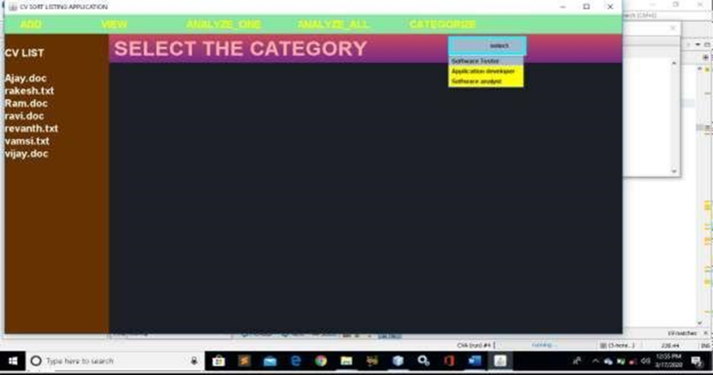

CATEGORIZE
READ THE CONTENT

Slide 26
System Testing:
Unit testing
Unit testing involves the design of test cases that validate that the internal program logic is functioning properly, and that program inputs produce valid outputs.
All decision branches and internal code flow should be validated. It is the testing of individual software units of the application it is done after the completion of an individual unit before integration.
Integration testing
Integration tests are designed to test integrated software components to determine if they actually run as one program.
Integration tests demonstrate that although the components were individually satisfied successfully by unit testing, the combination of components should be correct and consistent.

Slide 27
Functional Testing:
Functional tests provide systematic demonstrations that functions tested are available as specified by the business and technical requirements, system documentation, and user manuals.
Functional testing is centered on the following items:
Output : identified classes of application outputs must be exercised.
Systems/Procedures: interfacing systems or procedures must beinvoked.
Valid Input | : identified classes of valid input must be accepted.
Invalid Input | : identified classes of invalid input must be rejected.
Functions | : identified functions must be exercised.

Slide 28
System Testing:
System testing ensures that the entire integrated software system meets requirements. It tests a configuration to ensure known and predictable results.
An example of system testing is the configuration oriented system integration test. System testing is based on process descriptions and flows, emphasizing pre-driven process links and integration points.
Test objectives:
All field entries must work properly.
Pages must be activated from the identified link.
The entry screen, messages and responses must not be delayed.

Slide 29
Test strategy and approach:
Features to be tested
Verify that the entries are of the correct format
No duplicate entries should be allowed
All links should take the user to the correct page.
INTEGRATION TESTING:
Software integration testing is the incremental integration testing of two or more integrated software components on a single platform to produce failures caused by interface defects.
The task of the integration test is to check that components or software applications
Ex; components in a software system or – one step up – software applications at the company level – interact without error.
Test Results: All the test cases mentioned above passed successfully. No defects encountered.

Slide 30

Acceptance Testing:
User Acceptance Testing is a critical phase of any project and requires significant participation by the end user. It also ensures that the system meets the functional requirements.
Test Results: All the test cases mentioned above passed successfully. No defects encountered.

Slide 31
CONCLUSION:
In recent years, all industries and IT companies feel high burden to analyze all resumes provided by the candidates who are willing to participate job requirement processes so we need automated system for analyzing and shortlisting the all resumes at a time and also calculate the grades of the persons and their individual grades in each section like experience ,skills, education background , languages known and number of projects did. So this project will help almost all companies who are willing to analyze all resumes at a time without putting any human effect.

Slide 32
FUTURE ENHANCEMENTS:
In future cv analysis is required for each and every organization and adding additional features like “formats of the resumes are independent for analysis and applying for a job “.
This will help to reduce the time taken to analyse all the cv that are received from many candidates who are willing to do the particular job that a company offers which can predict the traits of an individual using the group of tweets posted by him.
It is different from the approaches reviewed in the literature survey, in that it works with the group of tweets and does not take user’s profile into account. Further, the system makes use of the Hadoop framework to predict personality traits of multiple individuals at the same time.

Slide 33
THANK YOU...

